Slide 1
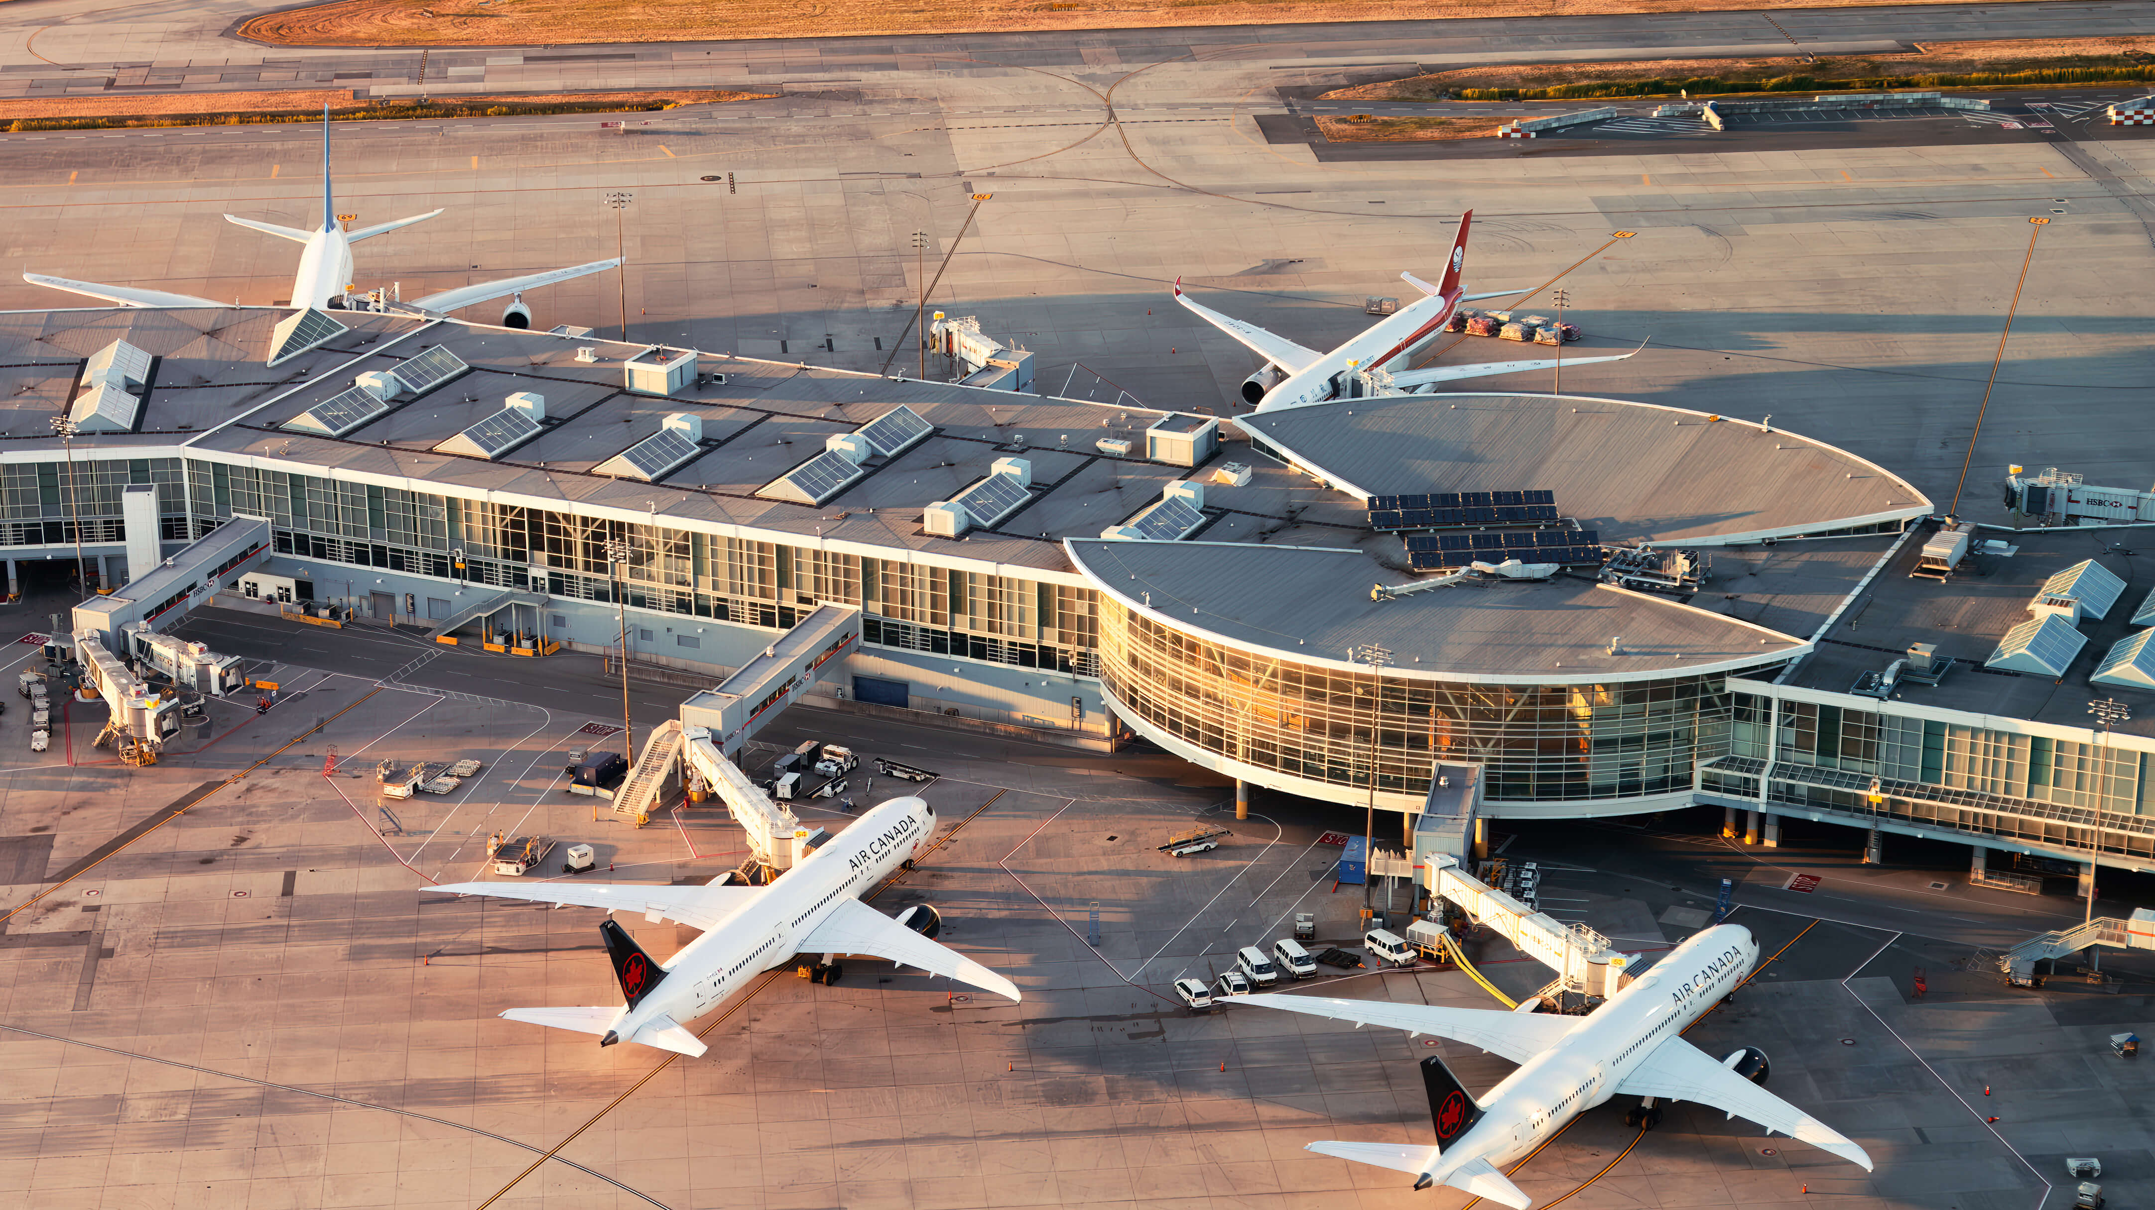
Analysis of Airport Security with Queueing Theory
Kaylee Vo, Tadhg Scannell
July 29th, 2025
Photos from https://skiesmag.com/news/yvr-retakes-top-airport-in-north-america-ranking/

Slide 2
Agenda
Problem and Motivation
Collecting Data
Models
M/M/c priority queue
Finding Parameters
M/N/c
Results
Sensitivity Analysis
Conclusion
Sources

Slide 3
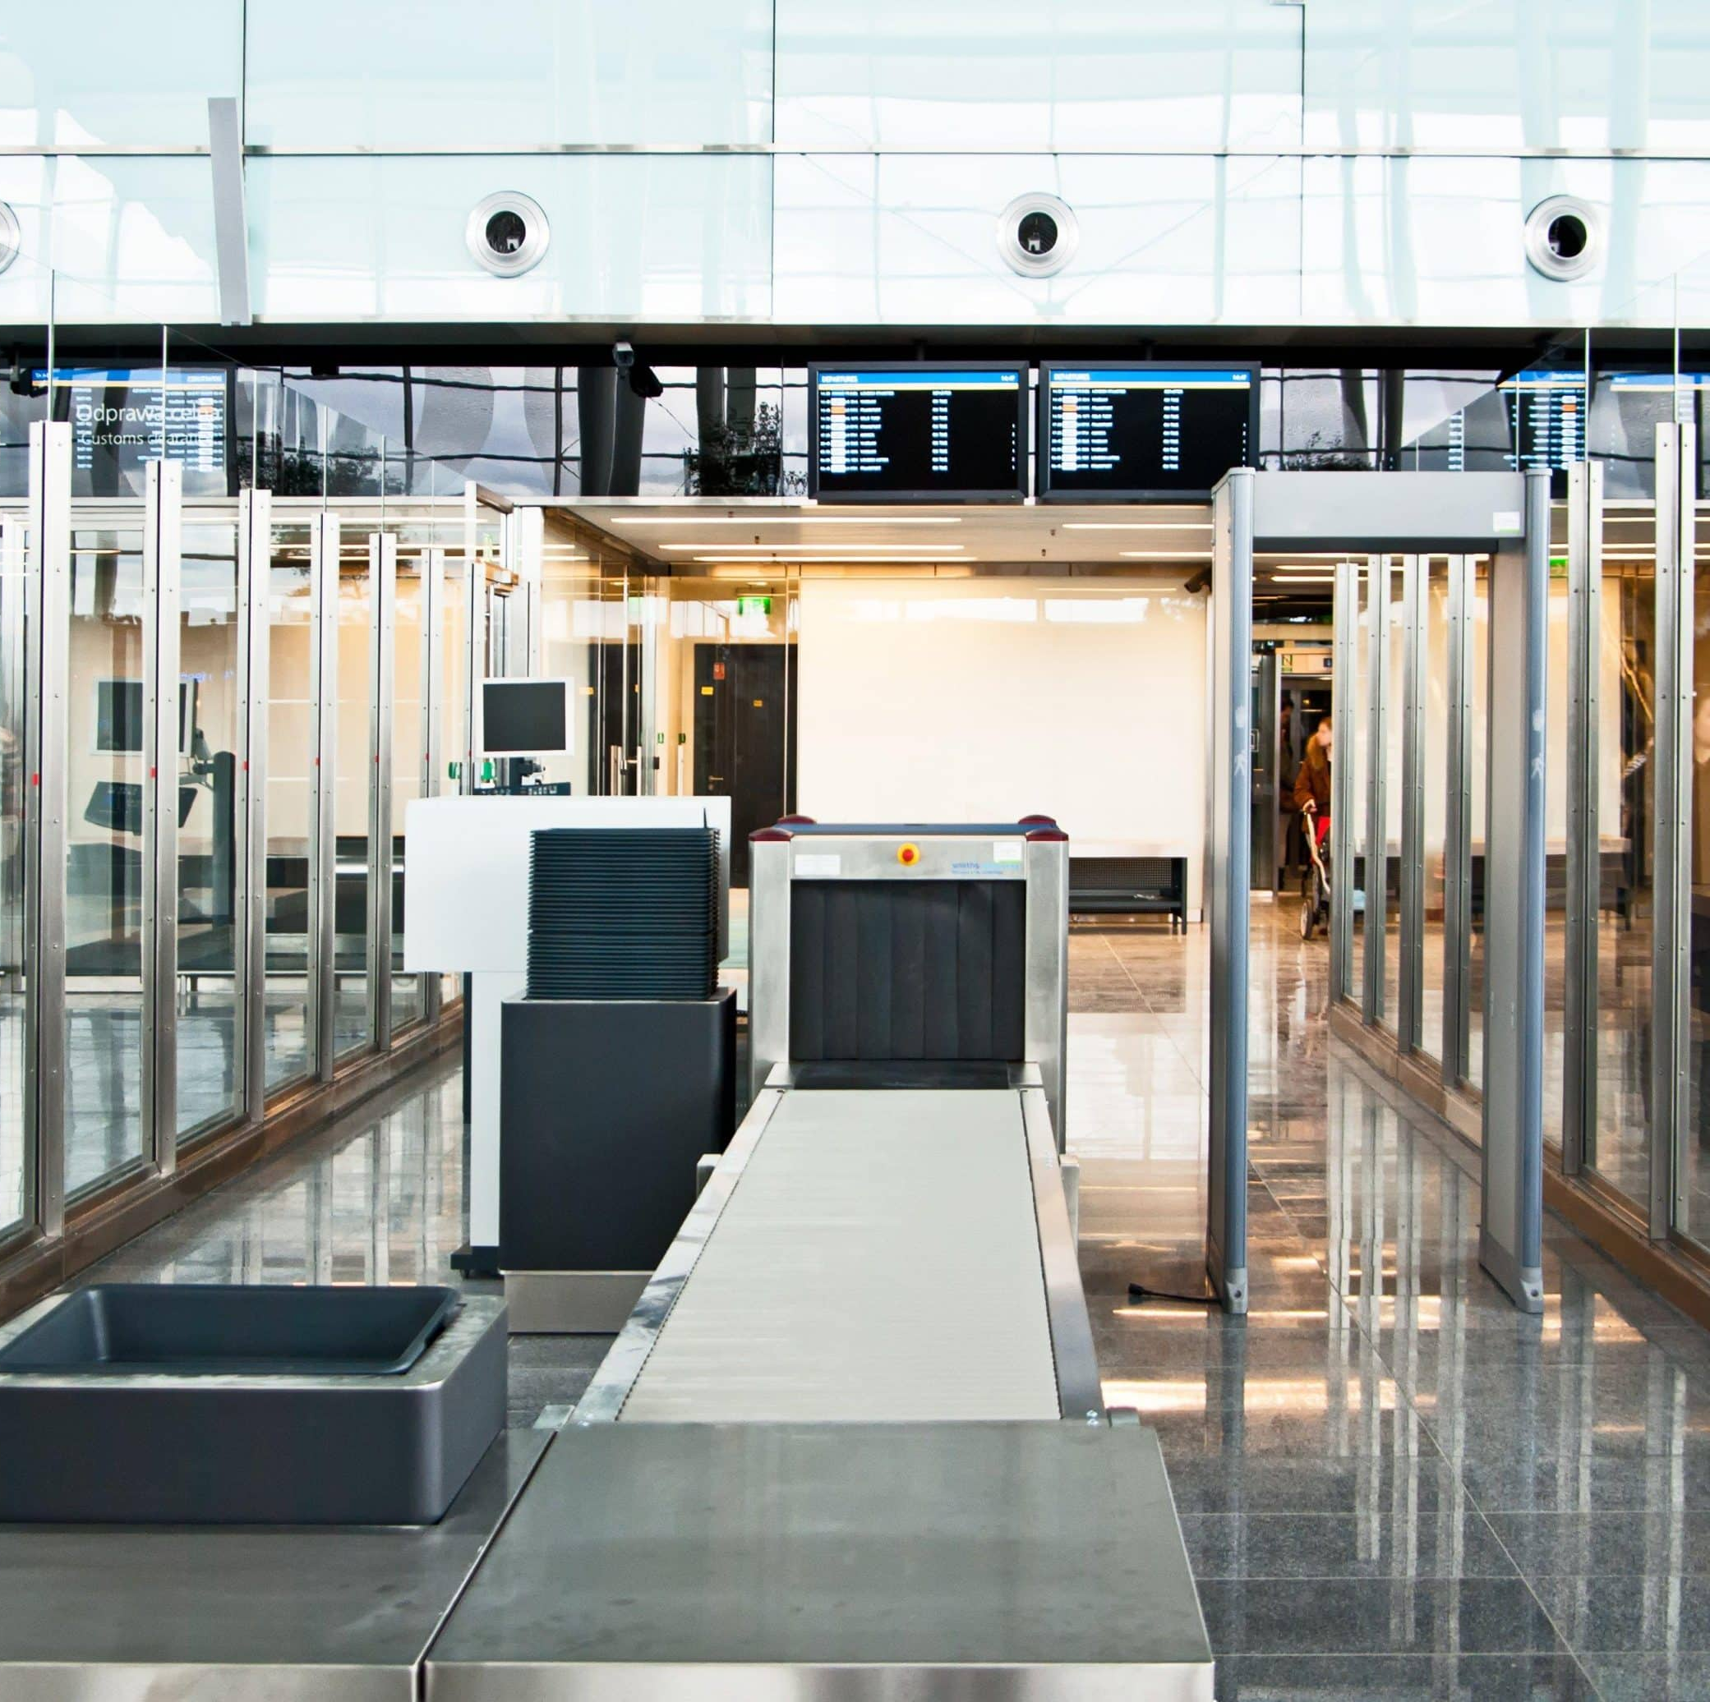
Problem and Motivation
Airport Security is a tedious but necessary process to ensure public safety while traveling commercially.
TSA Precheck offers a win-win to the TSA and the passengers.
Previous studies have evaluated Airport Security as parallel M/M/c queue.
How do we model security with a priority queue?
What is the cost associated with Airport Security?
The TSA administrator has stated a goal of 70% enrollment. What does this mean?
Photos from https://pointsecurityinc.com/types-airport-security-equipment/
Notes:
Tadhg

Slide 4
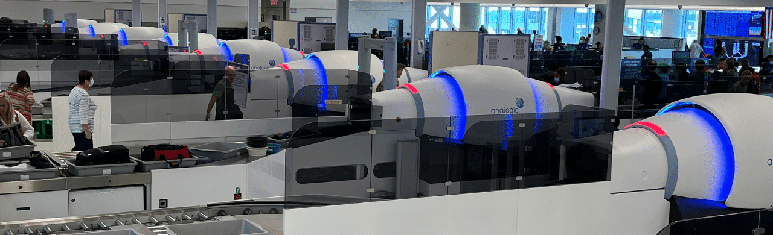
Modeling Airport Security as a Markov Chain (Li et al) [4]
Regular M/M/c has a known closed-form solution, which makes it useful for modeling.
The models we use will not have closed-form solutions, so we will use Monte Carlo simulations to identify long-term solutions.
Accommodates different passenger types with parallel queues (e.g., separate lines).
Approach 1
Use an M/M/c model with a priority queue.
Both interarrival times and service times are exponentially distributed, with PreCheck taking priority.
Photos from https://skiesmag.com/news/yvr-retakes-top-airport-in-north-america-ranking/
Notes:
Kaylee

Slide 5
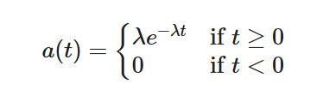
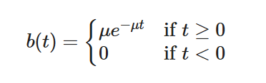
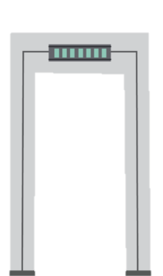
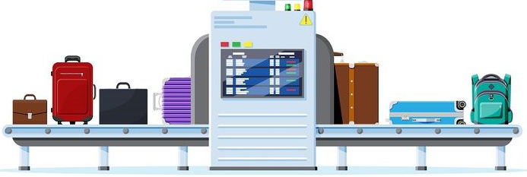


Finding Parameters
Interarrival Times
Service Times
Exponential distribution
Arrival Rate: λ
LAX data from Tom Bradley International terminal from 1-1-2025 to 7-21-2025 [1].
Took passengers per hour and converted to passengers per minute.
Exponential distribution
Service Rate: μ
Optimizer with Erlang’s C
Photos fromhttps://www.creativefabrica.com/product/metal-detector-airport-security-icons/ and https://www.pinterest.com/pin/airport-security-scanner-conveyor-belt-with-passenger-luggage--992410467864784672/
Notes:
Kaylee

Slide 6
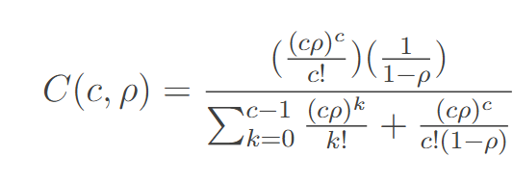
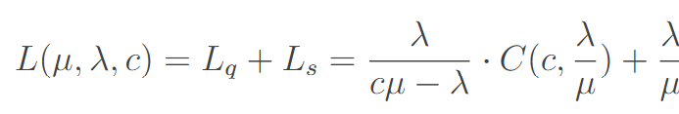
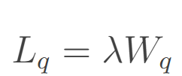
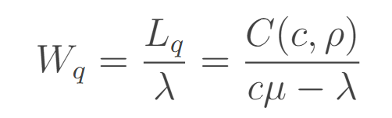
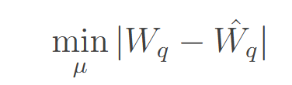
Approximating μ
Available data:
Passenger wait times in Passport Control [3]
Assumptions
Recorded data is representative of a M/M/C queue
Passport Control and Security Lines are equivalent service rates
Coefficients
Server Count: c
Server utilization: ρ
Arrival Rate: λ
Service Rate: μ
Concepts
Erlang C: the probability that an arriving customer is forced to join the queue
Little’s Law: the average number in the system is equal to the product of the arrival rate and the average system time. [11]
Result:
μ_{reg} = 1.91
μ_{reg} = μ_{reg} *1.33 [9] = 2.262
Average Customers
Little’s Law
Minimize L1
Erlang’s C Approximation
Notes:
Kaylee

Slide 7
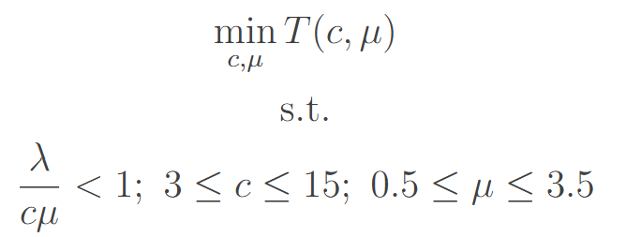

Optimizing Based on Cost
Determine minimum cost as a function of available servers and service rate.
Set variables:
TSA Base Pay: c_{s} = $30 [7]
Customer Opportunity Cost: c_{w} = $37 [2]
Service Rate per server per hour : c_{μ} = $1.8 [8]
Decision variables:
Server Count: c
Service Rate: μ
Inferences:
The optimal policy is to operate 12 servers, with a 2.4 passenger service rate.
Notes:
Kaylee

Slide 8
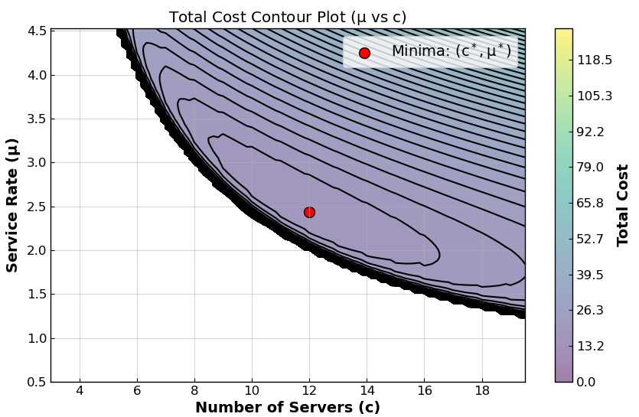
Optimizing Based on Cost
Notes:
Kaylee

Slide 9
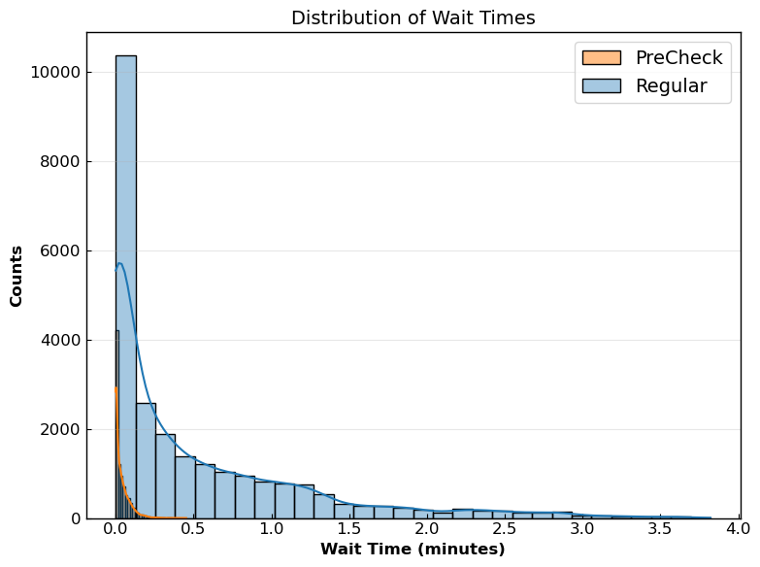
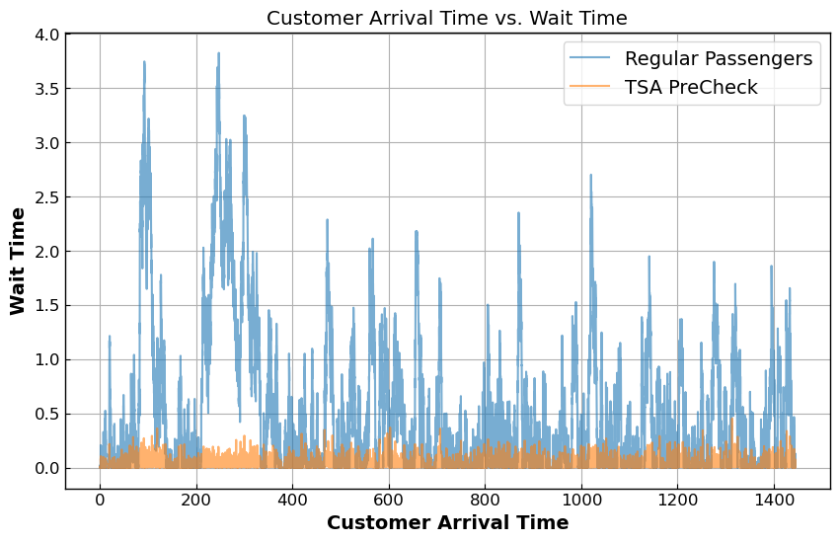
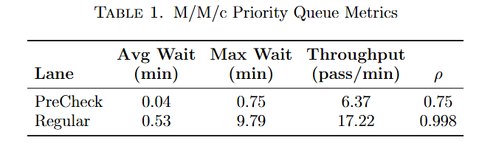
M/M/c Priority Queue Model
New Coefficients
Arrival Rate: λ = 23.6*
Standard Service Rate: μ_{reg} = 1.97*
Precheck Service Rate: μ_{pre} = 2.262*
Server Count: c = 12
Precheck Percentage: p_{pre} = 27%
Simulation Details
Run 500 simulations.
Average over all to collect average wait time, maximum wait time, and passenger throughput.
*rates are in passengers/minute
Notes:
Kaylee

Slide 10
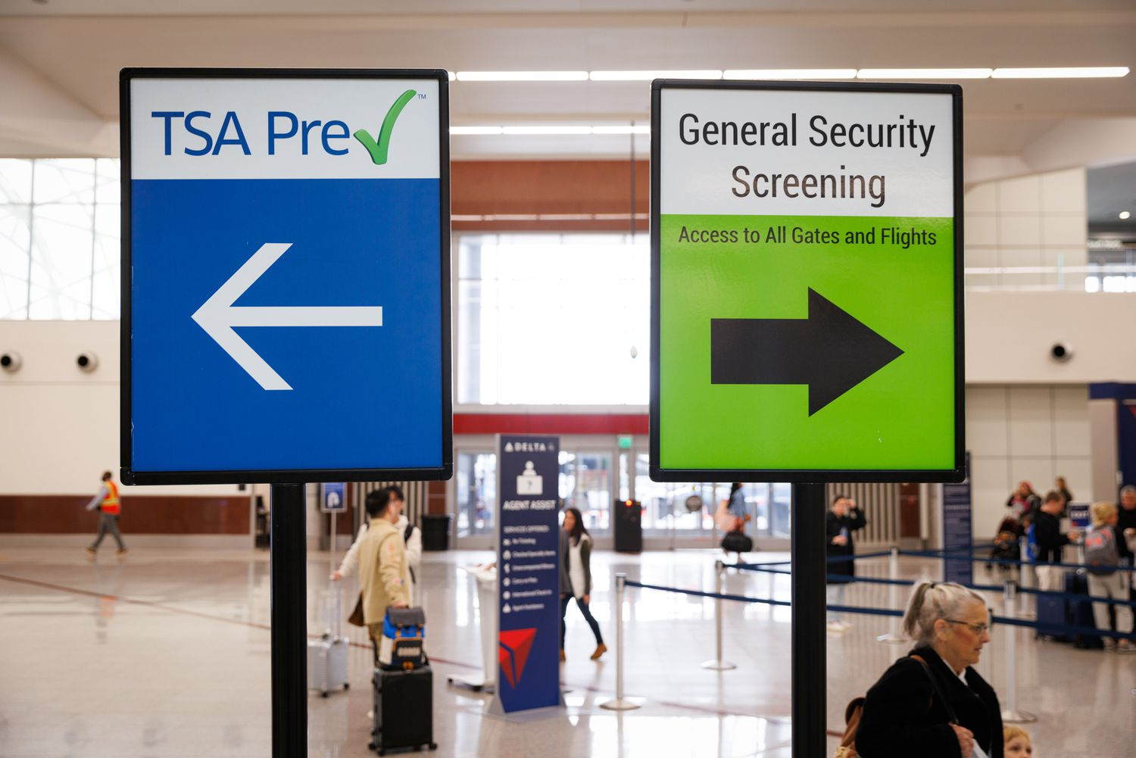
Parallel M/N/c
Next, we model the system as separate lines, representative of an airport security checkpoint.
We modeled the service times through a normal distribution.
Given the difficulty in identifying service rates, we elected to make assumptions about the standard deviations of service rates.
We reduced the scope from 12 servers down to 4, which represents 1 checkpoint in a terminal.
These servers are split, with 1 server supporting Precheck and 3 supporting standard screening.
There are two questions we want to answer
What is the optimal price to minimize wait time?
If the TSA Precheck member goes to 70%, what is the outcome on the wait times?
Photos from https://www.travelandleisure.com/how-to-get-tsa-precheck-for-free-11730356
Notes:
Tadhg

Slide 11
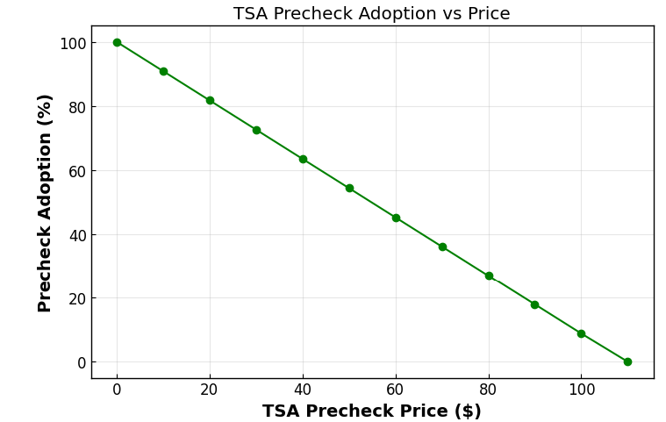
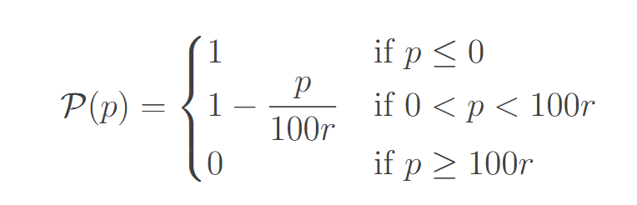
Demand Modeling
Model demand using a linear equation, with the values of 30% participation [5] at $76.75 [6].
Assume that 100% participation at $0 cost.
This leads to a $1.096 per 1% change in participation.
New Coefficients
p: TSA PreCheck subscription price
r: change in participation percentage per dollar
Notes:
Tadhg

Slide 12
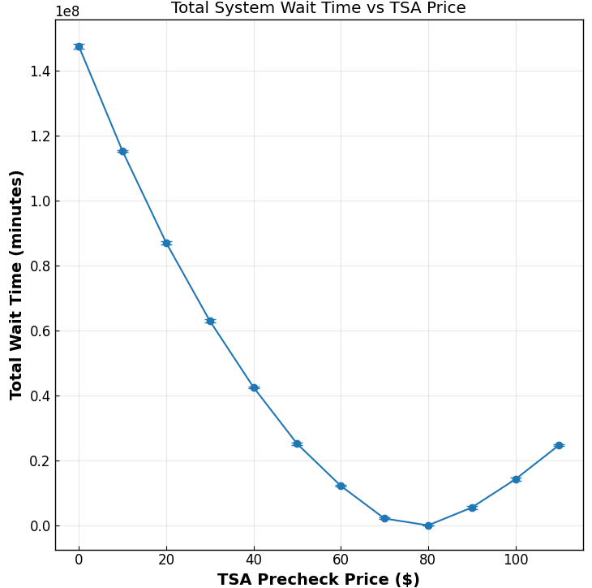
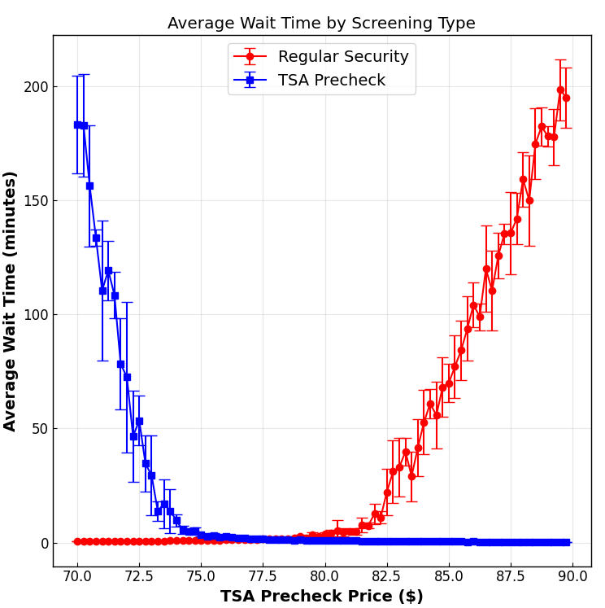
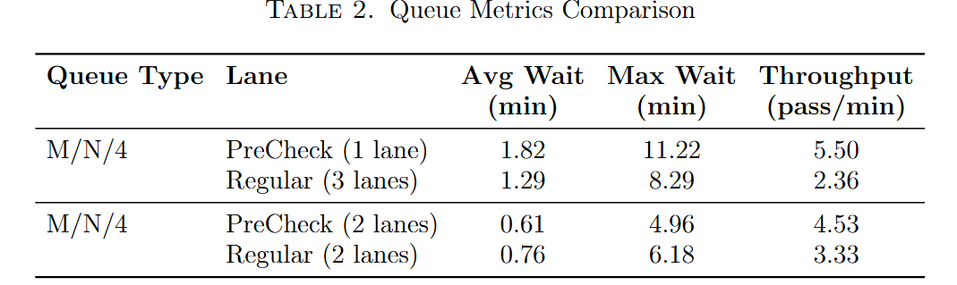
Parallel M/N/4 Results (1 TSA lane, 3 regular lanes)
New Coefficients
λ = 7.866*
μ_{reg} = 1.97*
μ_{pre} = 2.262*
Identify Optimal Price
1. Ran simulations ranging from $0 to $120, in $10 increments, 5 simulations per price.
2. Ran simulations ranging from $70 to $90, in $0.25 increments, 5 simulations per price.
Optimal price: $76.75 → 30.5% participation.
Determine Statistics
Run 500 simulations.
Gathered average wait time, maximum wait time, and passenger throughput.
*rates are in passengers/minute
Notes:
Tadhg

Slide 13
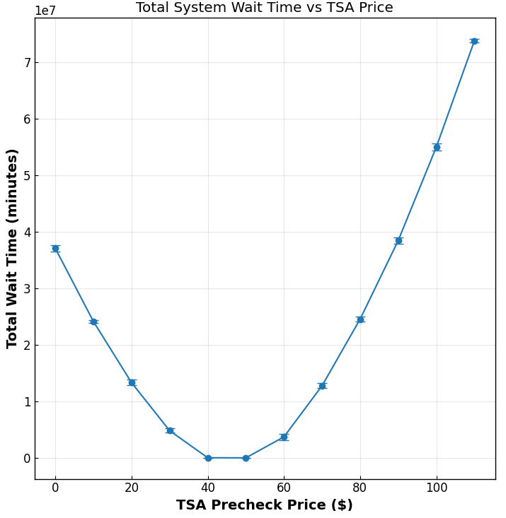
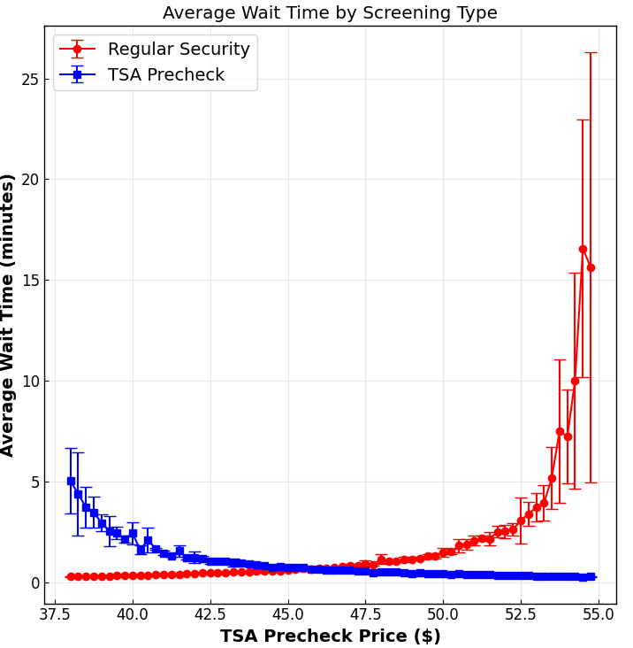
Parallel M/N/4 Results (2 TSA lane, 2 regular lanes)
New Coefficients
λ = 7.866*
μ_{reg} = 1.97*
μ_{pre} = 2.262*
Identify Optimal Price
1. Ran simulations ranging from $0 to $120, in $10 increments, 5 simulations per price.
2. Ran simulations ranging from $38 to $55, in $0.25 increments, 5 simulations per price.
Optimal price: $46.50 → 57.6% participation.
Determine Statistics
Run 500 simulations.
Average over each to collect average wait time, maximum wait time and passenger throughput.
*rates are in passengers/minute
Notes:
Tadhg

Slide 14
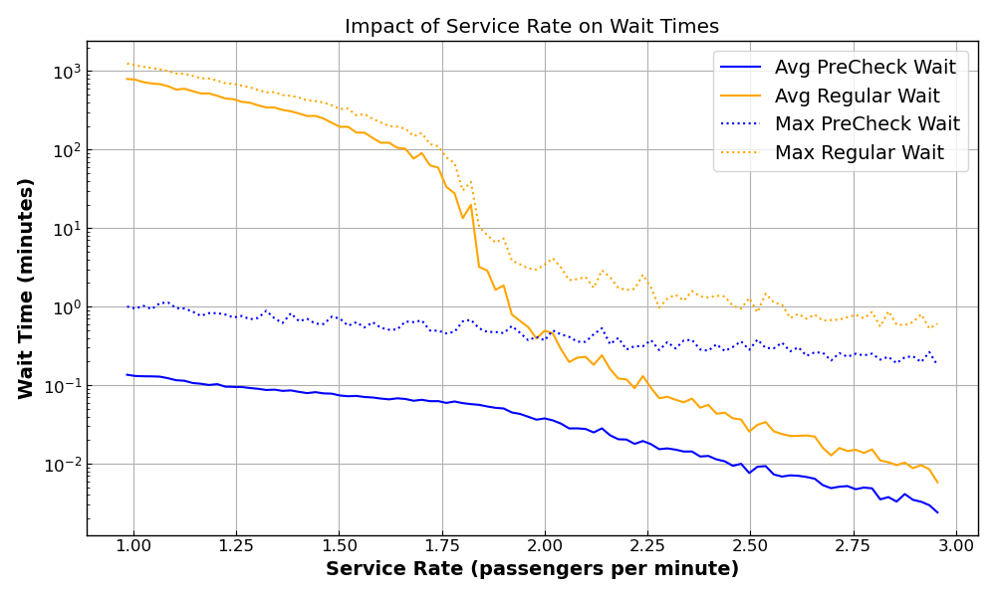
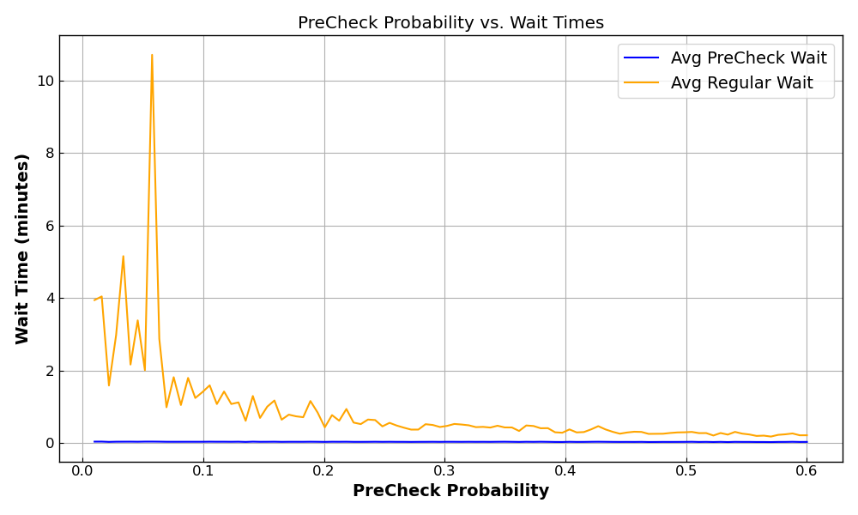
Sensitivity Analysis
Notes:
Kaylee

Slide 15
Conclusions
Built a priority queue M/M/c Model.
Identified parameter values from research and inference.
Optimized total cost under M/M/c priority queue design.
Modified M/M/c to an M/N/c parallel (separate lines) model to simulate a single checkpoint.
Explored different TSA participation rates and effects on wait times.
Examined the sensitivity of our results to parameters

Slide 16
Sources
[1] Bradley, T. (2003). Staff and Lane Modeling Methodology for TSA Checkpoint Passenger Screening. In Transportation Research Board. Transportation Research Board. Retrieved July 23, 2025, from https://www.trb.org/publications/circulars/ec060/06\_Bradley.pdf
[2] DeMarco, J. (2025, April 8). Average US salary by State | SOFI. SoFi. https://www.sofi.com/learn/content/average-salary-in-us/
[3] Keefe, M. L. (n.d.). Customs and Border Protection (CBP) - CBP Airport Wait Times (AWT). https://awt.cbp.gov/
[4] Li, Y., Ma, L., Zhang, Y., \& Yang, W. (2017). Stability analysis and optimization of airport security system. Engineering Management Research, 6(1), 56. https://doi.org/10.5539/emr.v6n1p56
[5] Sachs, A. (2024b, December 5). Have we reached peak PreCheck? The Washington Post. https://www.washingtonpost.com/travel/2024/11/28/tsa-precheck-vs-standard-security-line/
[6] Transportation Security Administration. "Apply for TSA PreCheck®." TSA Enrollment by IDEMIA, tsaenrollmentbyidemia.tsa.dhs.gov/programs/precheck.
[7] Transportation Officer hourly salaries in Los Angeles, CA at TSA (Transportation Security Administration). (2025). Indeed. Retrieved July 27, 2025, from www.indeed.com/cmp/TSA-(transportation-Security-Administration)/salaries/Transportation-Officer/Los-Angeles-CA?period=hourly
[8] TSA boosts recruitment incentive to attract applicants for security screening positions at Denver International Airport. (2022). www.tsa.gov. Retrieved July 27, 2025, from https://www.tsa.gov/news/press/releases/2022/11/08/tsa-boosts-recruitment-incentive-attract-applicants-security
[9] United States Government Accountability Office. (2018). AVIATION SECURITY TSA uses currentassumptions and Airport-Specific data for its staffing process and monitors passenger wait timesusing daily operations data. In Report to Congressional Committees [Report]. https://www.gao.gov/assets/gao-18-236.pdf
[10] Wikipedia contributors. (2023, December 20). M/M/c queue. Wikipedia. https://en.wikipedia.org/wiki/M/M/c\_queue
[11] Wikipedia contributors. (2025, June 2). Little’s law. Wikipedia. https://en.wikipedia.org/wiki/Little\%27s\_law

